Slide 1
Indexes-- MongoDB
--Govardhan R S
161086

Slide 2
To create and Drop Indexes
To create index:
db.collection.createIndex( <key index type specification>, <option>)
To Drop index
db.collection.dropIndex( <key index type specification>, <option>)

Slide 3
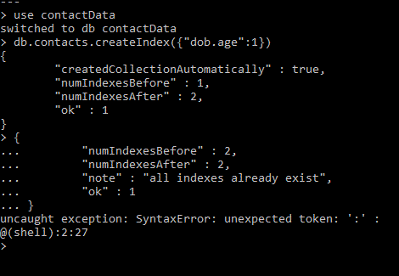
Create Indexes

Slide 4
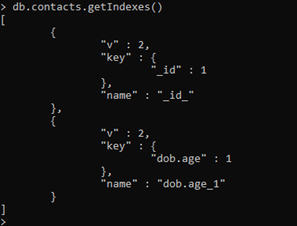
Get Indexes

Slide 5

Drop indexes

Slide 6
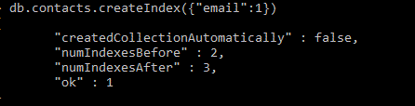
Single index

Slide 7
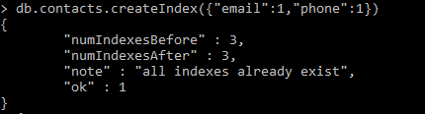
Compound index

Slide 8
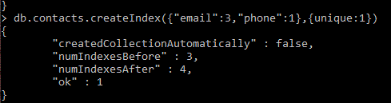
Unique index

Slide 9
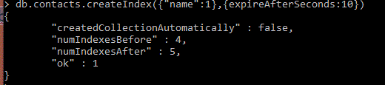
TTL index

Slide 10
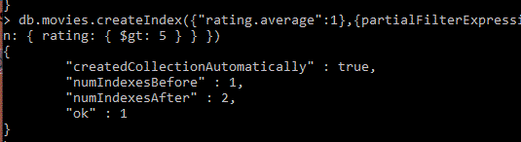
Partial filter index

